Slide 1
Welcome to Arabic Level I by Kurzban

Slide 2

Lesson 9: الدرس التاسع
Objectives: Connecting the letters
Review: Pronouns
Inquiring about and identifying place of origin
Colloquial Arabic
Practice
Finishing posters.

Slide 3
Connect the following letters to form words and write the transliteration to each.
شَ+ر+و+ق=
فِ+نْ+جَ+ا+ن=
خُ+بْ+ز=
تَ+و+ا+بِ+د=

Slide 4
Continue:
بَ+ه+و=
هِ+نْ+د=
شَ+هْ+ر+ز+ا+د=

Slide 5
Pronouns and reviewing Ha
Practicing with ha
I am
You are
You are
He is
She is
“This is “ for {F}
“This is” for {M}
ه+ذ+ا=
ه+ذ+ه=

Slide 6
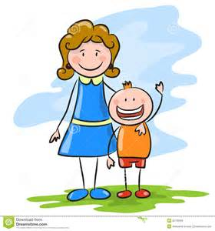

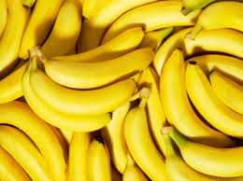
Introducing “M”
م بمب حم
At the end In the middle Initial
أم
خَمْسَة
مَوْز

Slide 7
Arabian horses a little background.
http://www.bing.com/videos/search?q=the+history+about+arabian+horses&FORM=HDRSC3#view=detail&mid=F041171CDB173EFE26EEF041171CDB173EFE26EE
desert rose song

Slide 8

Inquiring about and identifying Place of Origin
مِنْ أينَ أنْتِ؟
Where are you from?
The Arabic question is made up of the preposition min ( from), the question word ayna ( where ), and a personal pronoun either a (masculine or feminine)

Slide 9
Inquiring about…
Asking a woman about her place of origin requires the insertion of the second person singular feminine pronoun anti : أنْتِ
But
If you are asking about where a certain man comes from, you must use the third person singular pronoun huwa هُوَ(he) & use hua هِيَ (she) to refer to a woman.

Slide 10

Inquiring about and identifying Place of Origin
Where is he from? مِن أينَ هُوَ؟
Where is she from? مِن أينَ هِيَ؟

Slide 11
Working with pronouns
The response to such questions involves the use of a personal pronouns, the preposition مِن from and the place of origin, which may be a town, a region, or a county.

Slide 12
Lesson 9: Review
Copy down and translate the following words on your paper several times and remember to proceed from right to left.
بِخَيْر
جيم
صَباحُ الخَيُر
صَباحُ النور
حاء
شين
فاء

Slide 13
Inquiring about and identifying Place of Origin
Translate the following:
he is from ___________
She is from ___________
I am from ___________

Slide 14
Numbers
Review numbers 1-10 on line
http://www.purposegames.com/game/arabic-numbers-1-10-easy-quiz/info

Slide 15

Inquiring about and identifying Place of Origin
أنا مِنْ فاس
هُو مِن سورية
هِي مِن مصر

Slide 16
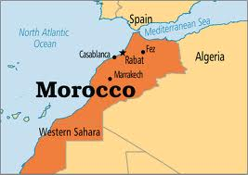
Where?
أيْنَ فاس؟
You may inquire about the location of a town with a question that contains the question word
أيْنَ “where” plus the name of that town.
فاس في المغرب

Slide 17
In….
فاس في المغرب
To answer our question, we need to use the name of the town, the proposition fi “in”, and the name of the country or state in which it is located.

Slide 18
Subject and Predicate
You might have noticed that we have not used a verb to be in the last few examples. Sentences that lack the verb to be, or do not start with a verb, are known as nominal sentences. It does not start with a verb. He subject or topic of the sentence may be a noun or a pronoun. The predicate can be a noun or a prepositional phrase.

Slide 19
Subject and Predicate
أنت ريما You are Reema
أنا من فاس I am from Fez
The examples above are made up of two parts: Subject and predicate. The subject is the focus ( I am) and fez. The predicate is the information about the subject such as from fez, from Morocco….

Slide 20
Subject and Predicate
مِنْ أينَ أنْتِ؟ [1
أنا مِنْ فاس
أيْنَ فاس؟ [2
فاس في المغرب
Now try some of your own

Slide 21
Colloquial Arabic
The type of Arabic that we have been introducing so far is the standard language used in education, the media, and formal situations.
The difference between Standard Arabic and any local colloquial Arabic may be limited to variations in pronunciations and other factors.

Slide 22
Colloquial Arabic Examples
The word أين can be expressed as وين or فين. In Syrian/Moroccan Arabic for example. One would ask:
فين/وين دِمَشق؟
Instead of
أين دِمَشق ؟

Slide 23
Colloquial Arabic Examples
How about this one:
من أينَ أنْتِ؟
Will be formed as :
منِين إنْتِ؟
The two words are collapsed into one.

Slide 24
Summary
Identify the letters:
س ، ش، ج، ح، خ، ف، ق، ة
In this segment from an Arabic newspaper

Slide 25
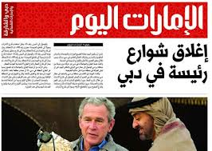
Summary
آخِرُ خَبَر
سَتَبْدَاُ غَداً الأحَدَ أعْمَالُ الدَورةِ التَدرِيبِيَّةِ للإعْلامِ الزِراعيِّ وَ الَّتِي تُقامُ بِرِعايَةِ السيِّدِ خَليل عَرْنُوق
وزيرِ الزِراعَة.

Slide 26

Meaning
Latest news
The Sunday's training session is going to start for agricultural information is and it is run by the Minister of Agriculture Mr. Khalil عرنوق

Slide 27
Mini-Quiz
ثَ +ب + ب +تَ=
ب + يْ +نَ =
=يَ + بُ + ثُ +ث
ب + يْ+ت =

Slide 28
Review
Review
Make your flash card for this lesson
Questions????

